Slide 1
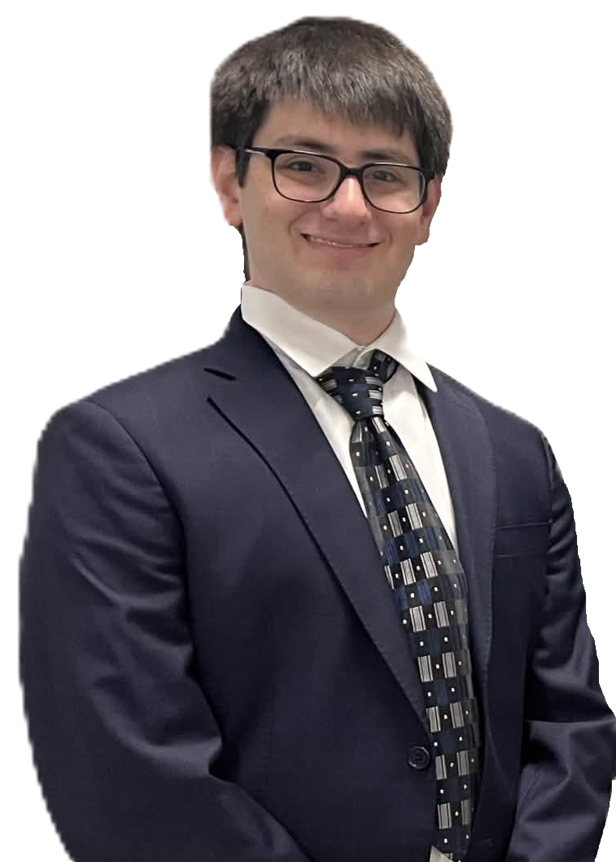
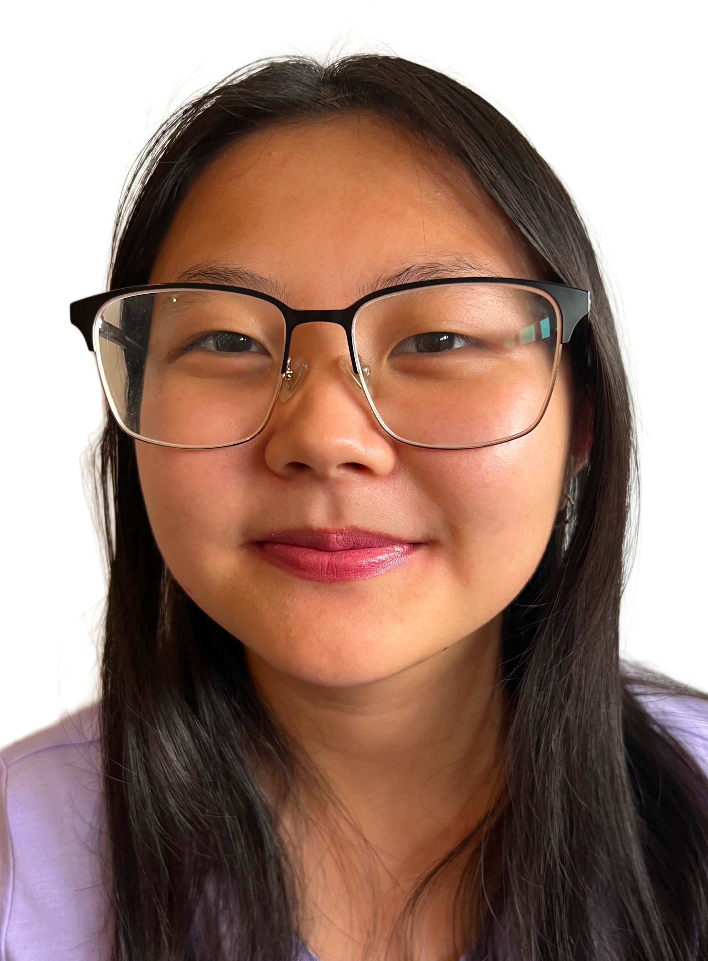


Group Project: Database For the Construction Submission Portal
Alexander Beck CS BS/MS
Tina Cheng CS Bachelor
Tran Man Tuyen Dinh Master of CS
Zongyu Mu Master of CS
Notes:
Hi everybody. We are the group 2 and we would like to present our group project: The database application for the Construction Submission Portal. In our group, we have Alex, Tina, Tuyen and Zongyu. The nature of this project falls strictly under the Database Application category. We are designing, developing, and implementing a fully functional Relational Database Management System (RDBMS) database application to power a real-world web application. Specifically, this project is a centralized platform designed to modernize the construction permit process. The core technical focus is engineering a robust relational database that allows design consultants to securely submit building plans - including 3D models and technical documents - to a central hub, enabling a complex workflow where multiple agency bodies can review, issue feedback, and approve the submissions in parallel.

Slide 2
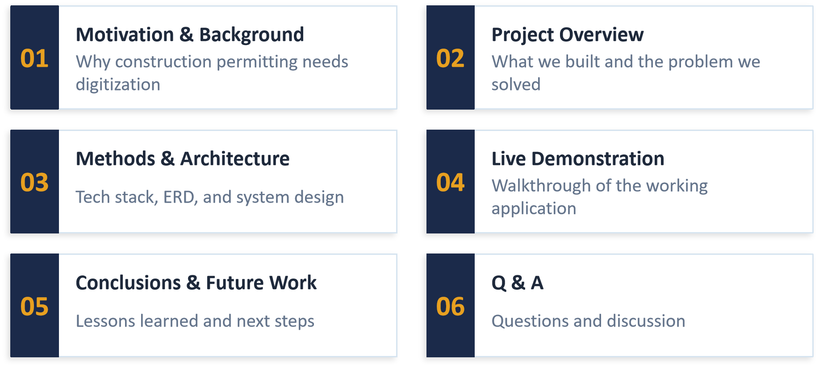
Presentation Agenda

Slide 3
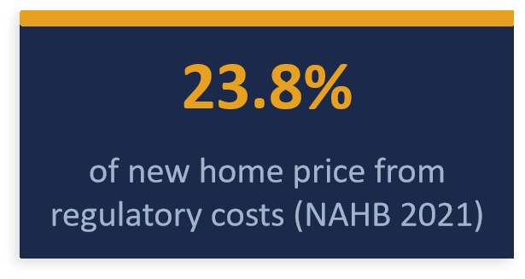
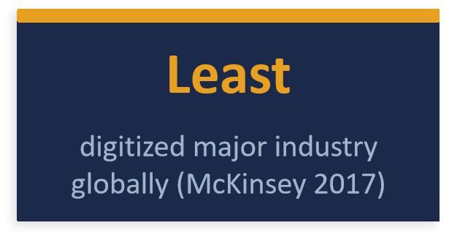
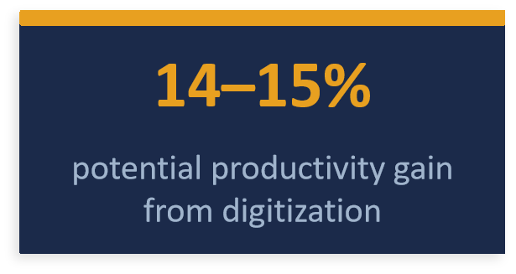
Motivation & Background
Real-World Problems We Address
Paper-Based Submissions
Lost records, duplicated documentation, no version control
Sequential Reviews
Agencies wait for each other; weeks-long bottlenecks
Version Control Issues
Agencies review outdated plans while v3 is already drafted
Cost of Delay
Thousands/day in developer interest during approval delays

Slide 4
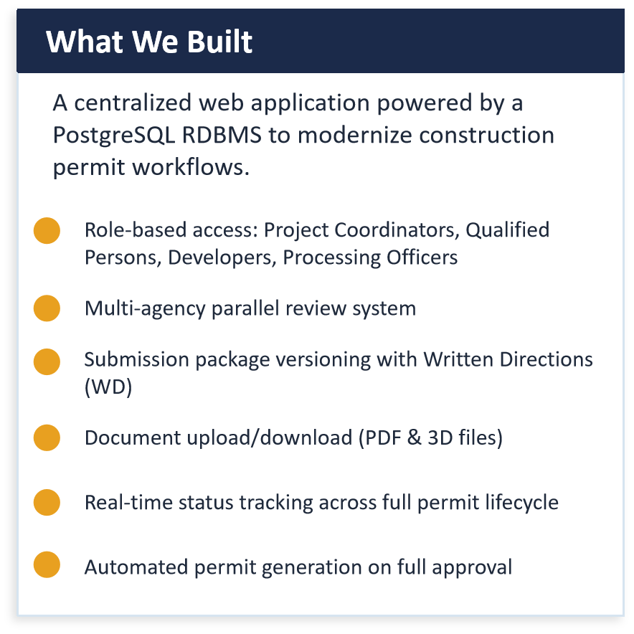
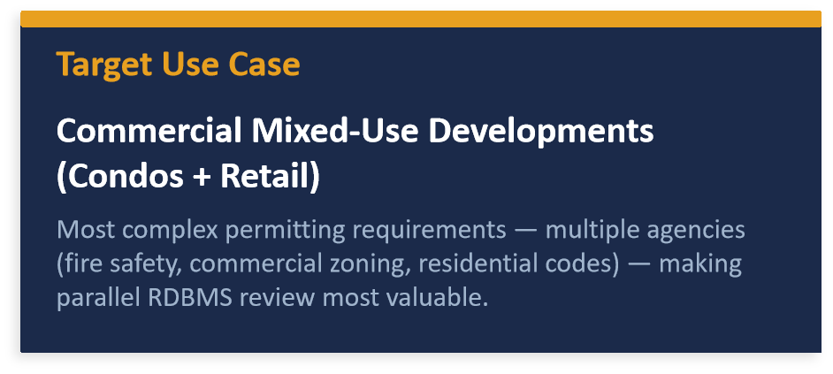
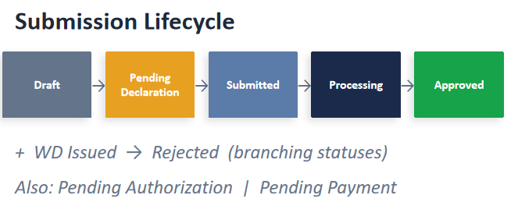
Project Overview

Slide 5
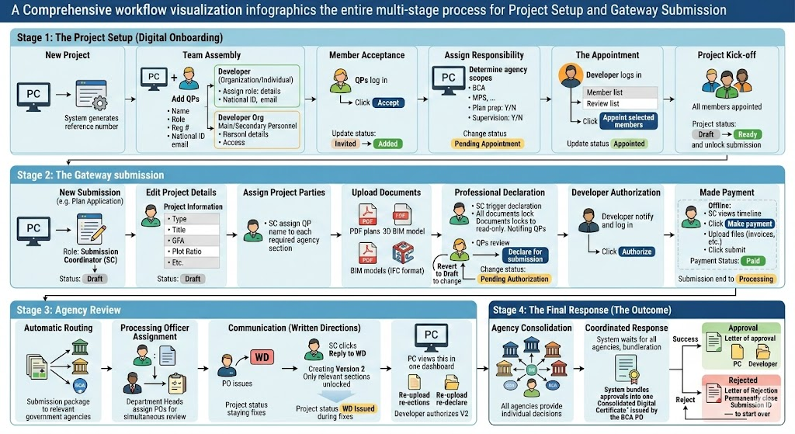

Slide 6
User Requirements
Project Coordinator: Creates projects, assembles teams, manages multiple projects simultaneously. Recorded: Name, Role, Reg. No., National ID, Email.
Qualified Person: Licensed professionals with multiple scope assignments. Can also serve as Submission Coordinator (SC).
Developer: Client entity (Individual or Organization) that authorizes the project team and submission packages.
Agency & Processing Officer: Reviews submissions, issues Written Directions (WD), assigns POs by expertise and project type.
Submission Package: Multi-versioned application instance with statuses: Draft → Pending → Submitted → Processing → Approved/Rejected.
Documents & WD: Technical files (PDF, 3D models) tracked per section with read-only lock flags. WD feedback linked to sections.

Slide 7
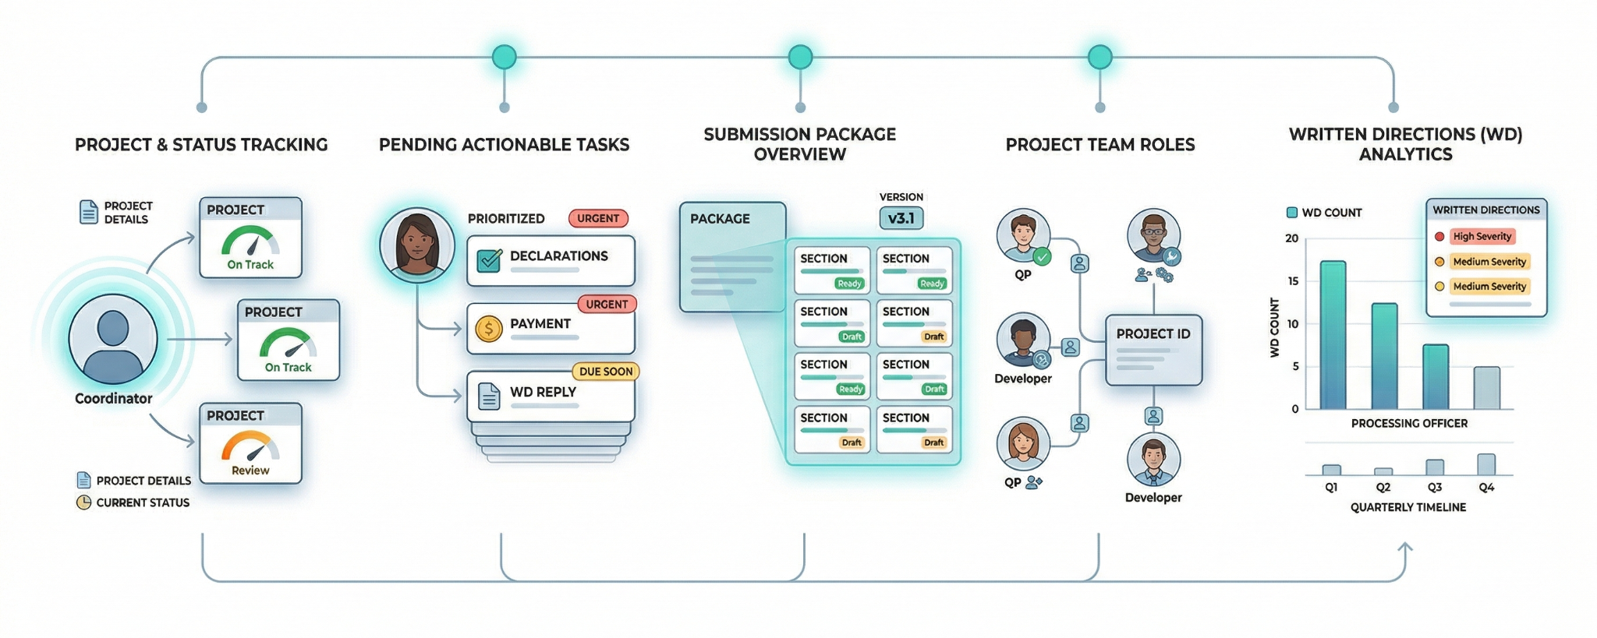
User Queries/Questions

Slide 8
User Queries
All projects & status managed by a specific Project Coordinator
All pending tasks (Pending Declaration / Payment / WD Reply) per user
All project members, roles & appointment status for a project
Latest submission version + section completion status per package
All 'Processing' submissions assigned to a specific agency officer
All Written Directions by severity & timestamp for a submission
Count of WDs per Processing Officer for a project type (last quarter)
All 'Approved' or 'Rejected' packages within a date range

Slide 9
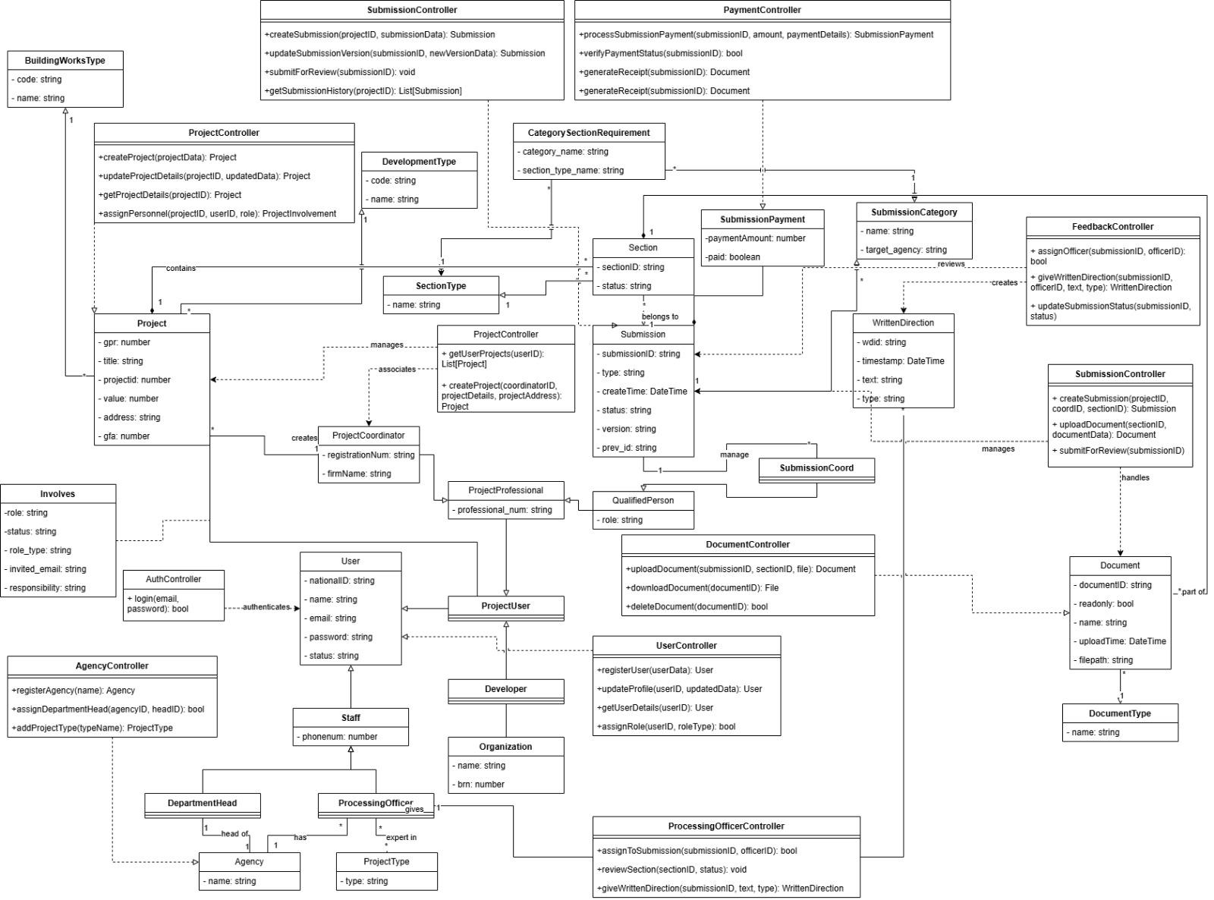
UML

Slide 10
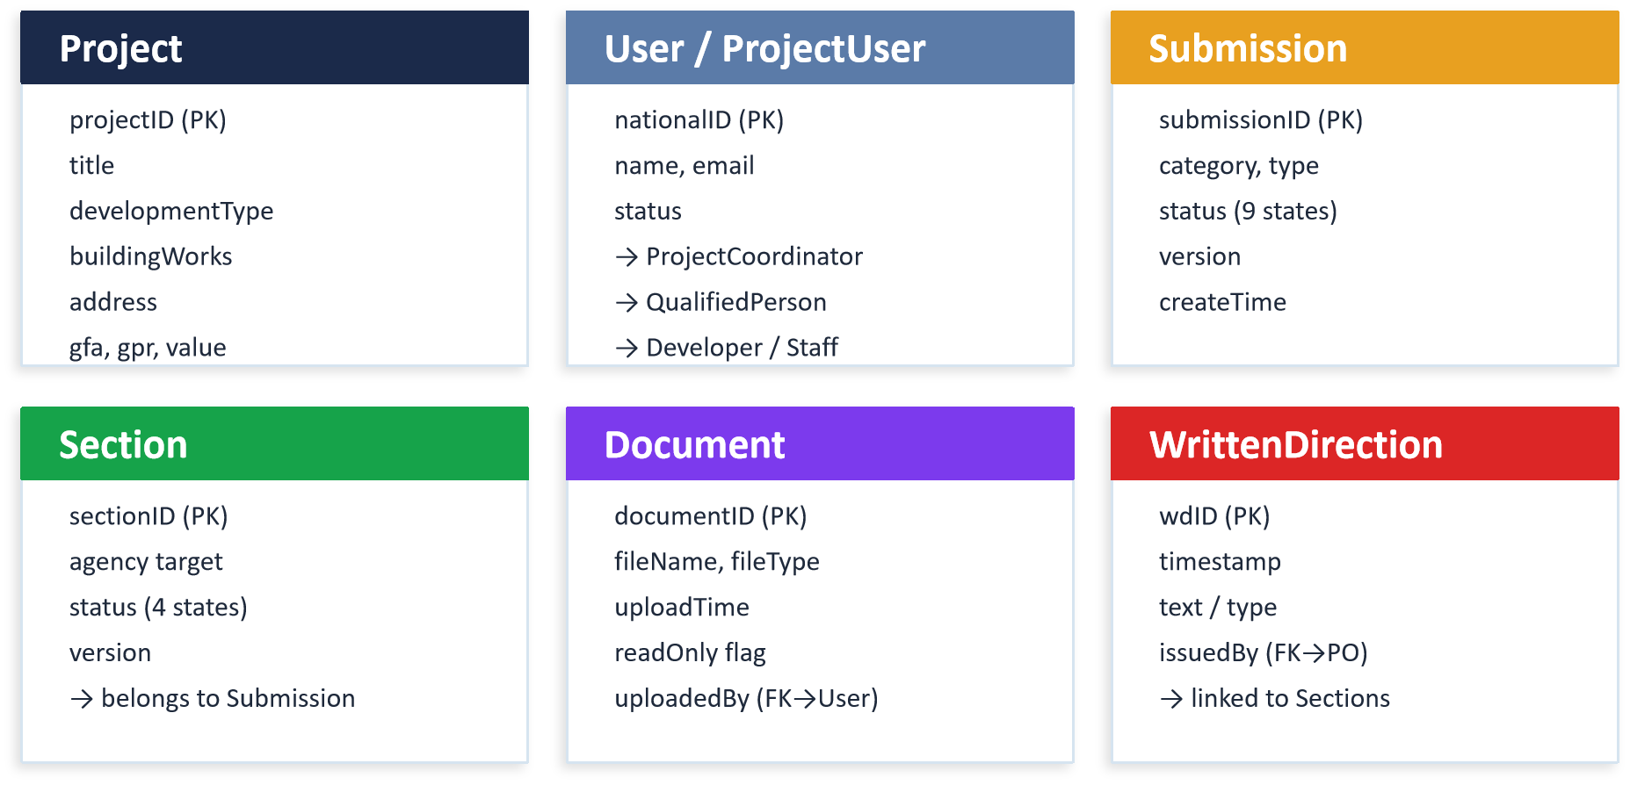
Database Design - Key Entities

Slide 11
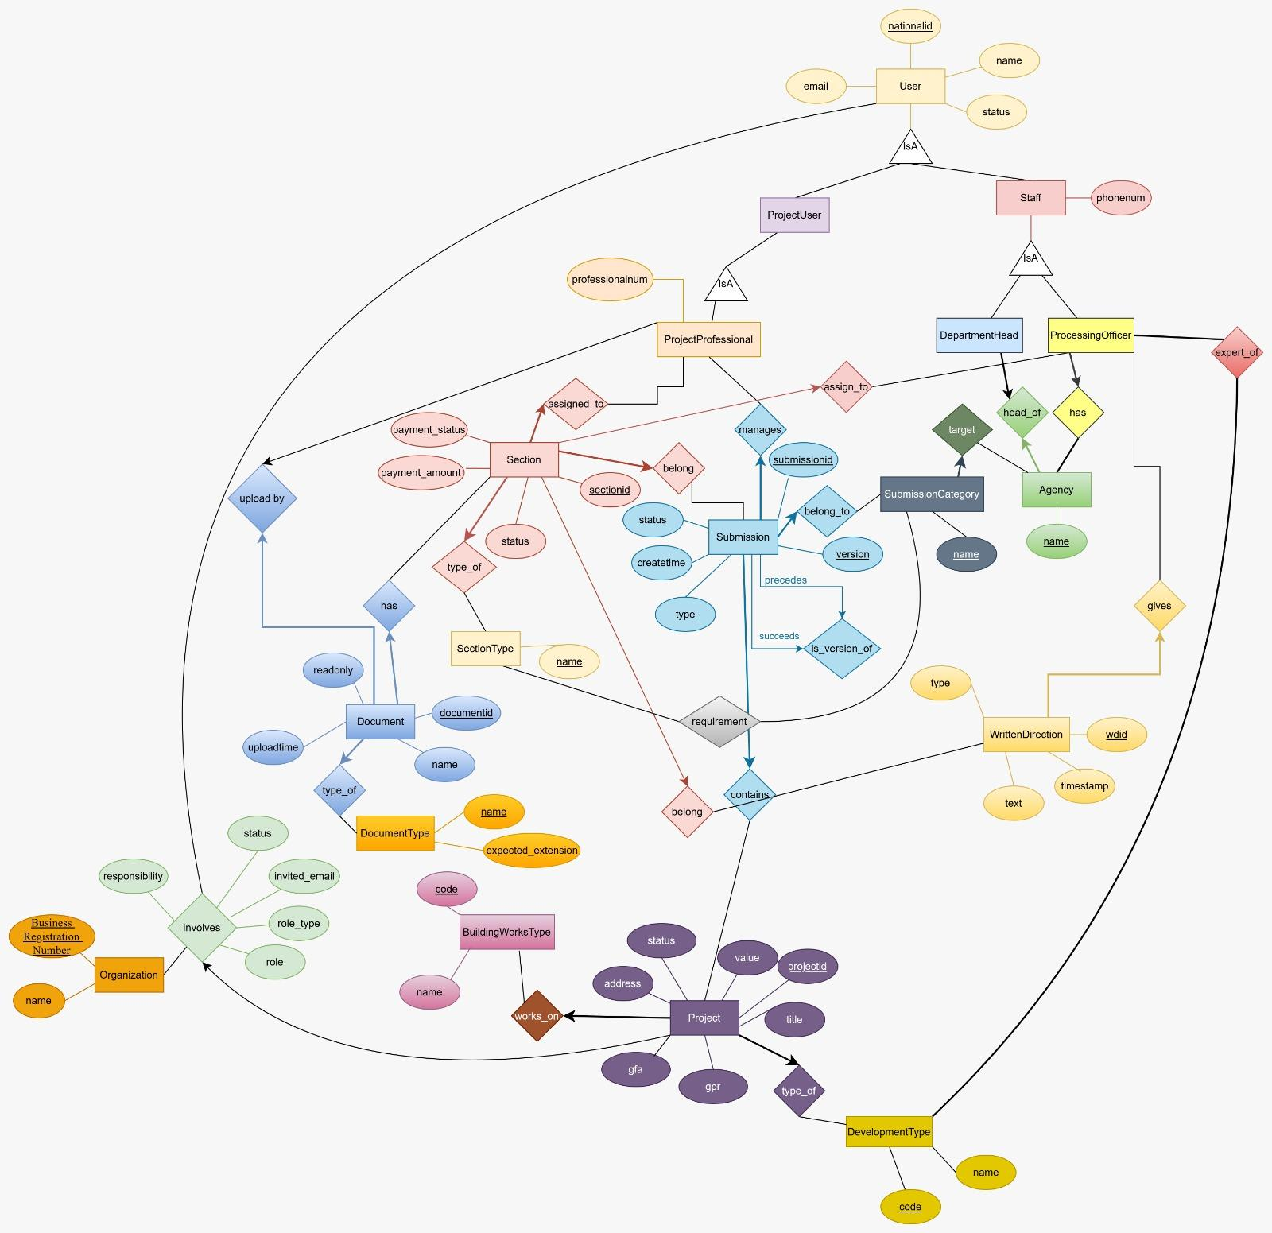
ERD

Slide 12
Tech Stack & System Architecture
Frontend
Backend
Database
HTML + CSS + Tailwind CSS
Login, Dashboard, Project Table, Submission Forms, File Upload UI, Review Pages
Python · FastAPI · SQLModel
REST API endpoints, authentication, file upload/download, validation logic, DB connection
PostgreSQL
Schema, constraints (FK, UNIQUE, CHECK, NOT NULL), triggers, permit generation logic
▸ HTML + CSS
▸ Tailwind CSS
▸ Login Page
▸ Project Table View
▸ File Upload Button
▸ PostgreSQL
▸ 20+ Relational Tables
▸ FK / UNIQUE / CHECK
▸ Triggers & Constraints
▸ Normalization

Slide 13
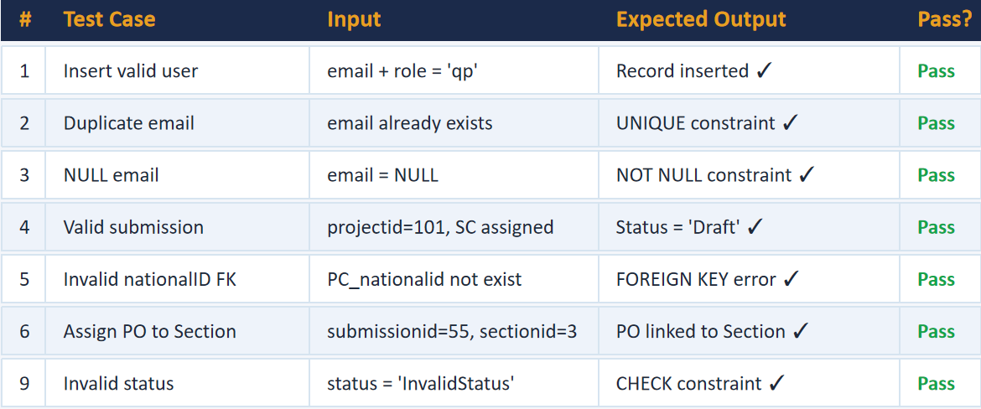
Unit test Cases - Validation

Slide 14
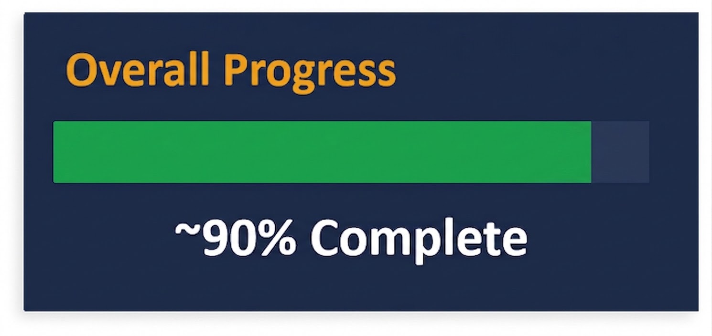
What We Accomplished
Completed
Future Enhancement
Backend & frontend framework setup
PostgreSQL schema with normalized tables
All constraints (FK, UNIQUE, CHECK, NOT NULL) via FastAPI/SQLModel
Backend-to-database connection
User authentication (login & registration)
Landing page & project table view
Create Project form (multi-step)
Submission Form + validation logic
File Upload & Download API
Agency review workflow & WD display
Status Update & Role-Based UI Restrictions
Full Dashboard
Cancel & Back Navigation polish
End-to-End integration testing
User Acceptance Testing (UAT)
Final documentation

Slide 15
Challenges & Lesson Learned
Increase complexity when changing the database
Planning ahead is crucial to reducing the amount of time needed to make changes
A QP can simultaneously act as a Submission Coordinator, creating ambiguous permission states.
Used separate role assignment tables to track dual roles per-submission, keeping the base user table clean.
Generating a new submission version while preserving the full history of sections and documents was non-trivial.
Version field on both Submission and Section tables, with parent-child linkage tracking revision chains.

Slide 16
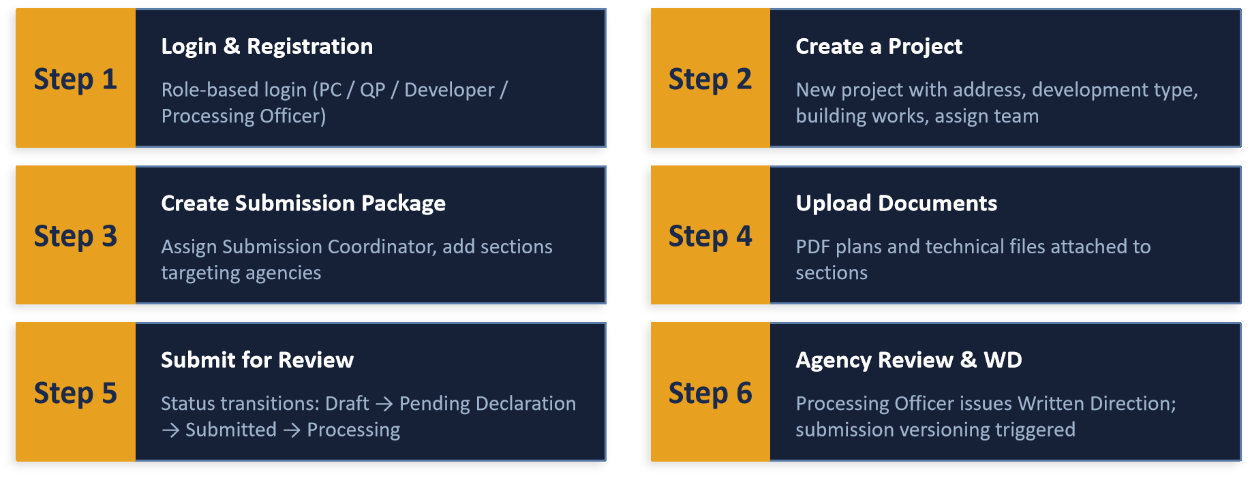
Live Demonstration
Walkthrough of the working application

Slide 17
Conclusion & Future Work
What we achieved
Future Enhancement
Fully functional RDBMS-backed web application for construction permit management
Robust normalized PostgreSQL schema with 10+ entities and enforced data integrity
Role-based access control for 4 distinct user types
End-to-end submission lifecycle from Draft to Approved with versioning
Parallel multi-agency review system eliminating sequential bottlenecks
File upload/download for PDF plans and 3D models
Email Notifications: Auto-notify stakeholders on status changes and WD issuance
Mobile Responsive UI: Full responsive layout for on-site field use
Analytics Dashboard: Processing time metrics, bottleneck identification per agency
Digital Signatures: Legally binding e-signatures for QP declarations
Third-party Integration: Connect to government agency APIs for real submission routing
Audit Trail: Immutable log of all status changes and document uploads

